Slide 1
Title of the project: Car Price Prediction Project

Slide 2
PROBLEM STATEMENT AND UNDERSTANDING
With the covid 19 impact in the market, we have seen lot of changes in the car market. Now some cars are in demand hence making them costly and some are not in demand hence cheaper.
There are lots of individuals who are interested in the used car market at some points in their life because they wanted to sell their car or buy a used car. In this process, it’s a big corner to pay too. To be able to predict used cars market value can help both buyers and sellers.

Slide 3
EDA STEPS AND VISUALIZATIONS
This involves generating summary statistics for numerical data in the dataset.
Creating various graphical representations to understand the data better.
We have performed initial investigation of data so as to discover patterns, to spot anomalies, to test hypothesis and to check assumptions and to find the correlation with the help of summary statistics and graphical representation.

Slide 4
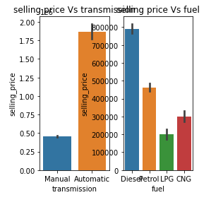
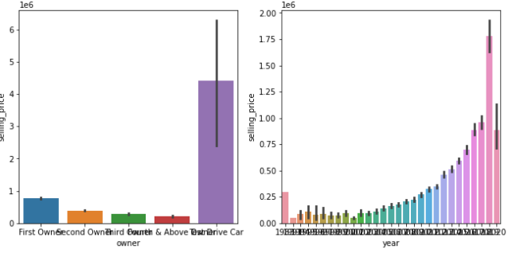
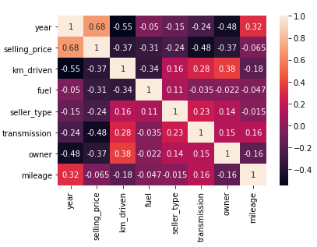
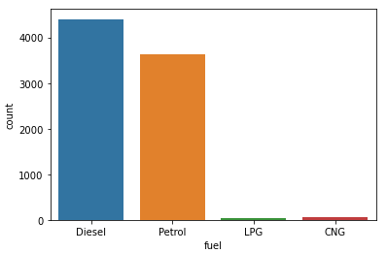
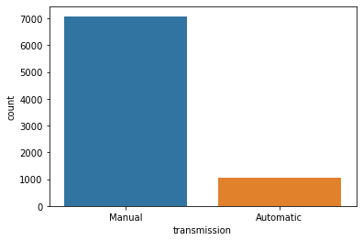

Slide 5
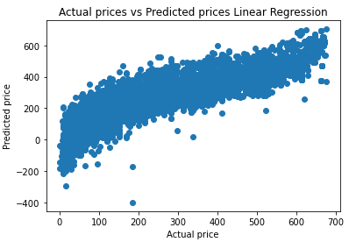
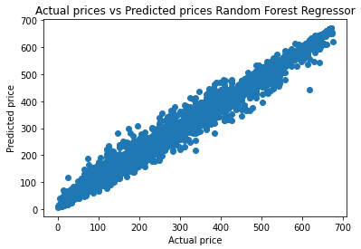
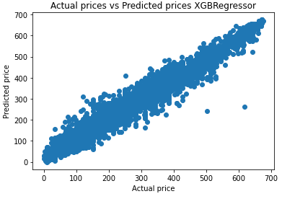
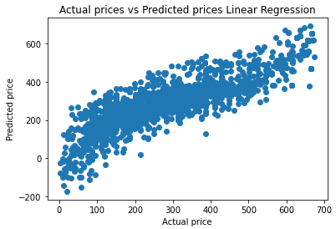
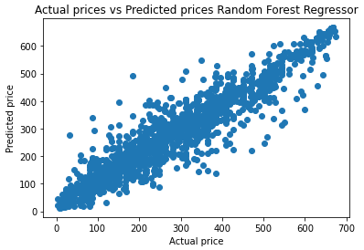
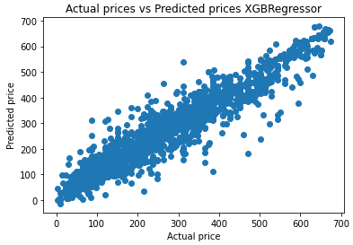

Slide 6
STEPS AND ASSUMPTIONS
In this project we have not assumed anything and since the data is collected using webscraping it has some missing values which we have handled.
After that, we splitted the data into training and testing set. We trained the model using five classification algorithms namely Linear Regression, Lasso Regression, Gradient Boosting Regression, Random Forest Regression and XGBoost Regression. And used hyperparameter tuning and created a scatter plot for predicted and actual prices which was shown in the above slide.
The first row are the graphs of training phase and second row are the graphs of testing phase.

Slide 7
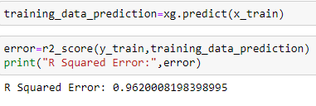
Finalized Model
Out of five classification models XGBoosting Regressor is giving the more R squared value with improved cross validation score. So we have finalized this model as the best fit for our dataset.
Thus we evaluated the model and plotted the graph for predicted and actual prices.

Slide 8
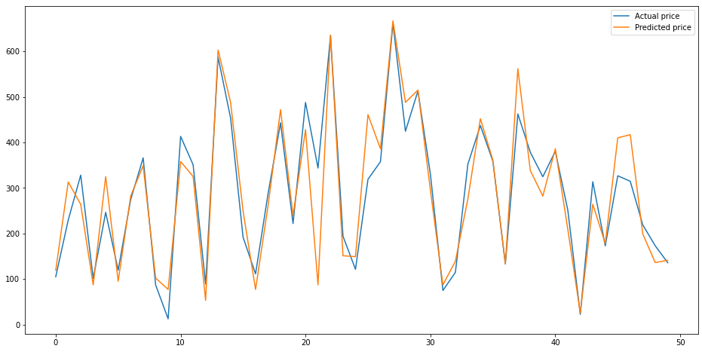
Thus the graph below shows the variations in the predicted and actual prices of the finalized model.

Slide 9
Conclusion
There is no definitive guide of which algorithms to use given any situation. What may work on some data sets may not necessarily work on others. Therefore, always evaluate methods using cross validation to get a reliable estimate.
Sometimes we may be willing to give up some improvement to the model if that would increase the complexity much more than the percentage change in the improvement to the evaluation metrics.
In some regression problems, r2_score may be less because of the data that have and we cannot judge this by only seeing a r2_score we should use some analytical techniques to find the best.
Missing values sometimes add more information to the model than we might expect. One way of capturing is to add.

Slide 10


